Slide 1
IBM University Engagement Project Submission
“Exploring the Power of Agentic AI with IBM Granite”

Slide 2

Project Tile – Interview Trainer Agent
Domain of Project – Education / Artificial Intelligence (AI)
Student Name | Recent Passport Photo | Email ID | Mobile number [WhatsApp]
Kartik Malve |  | kartikvmalve@gmail.com | 9579147160

Slide 3
Problem Statement -
Problem Statement :
Preparing for job interviews is challenging for students, fresh graduates, and professionals. Generic interview preparation methods do not provide questions and guidance based on individual skills, experience, and target job roles.
The Challenge:
Candidates struggle to find relevant technical and HR interview questions, prepare effective answers, identify knowledge gaps, and gain confidence. They also lack personalized feedback and realistic mock interview practice.
The Objective:
To develop an AI-powered Interview Trainer Agent using IBM Granite and RAG that analyzes resumes, generates personalized interview questions and answers, provides preparation strategies, conducts mock interviews, and evaluates responses with feedback to improve candidates' interview performance.

Slide 4
Proposed Solution -
Proposed Solution
The proposed solution is an AI-powered Interview Trainer Agent built using IBM Granite and Retrieval-Augmented Generation (RAG).
Resume Analysis: Analyzes uploaded resumes to identify skills, qualifications, and experience.
Personalized Questions: Generates interview questions based on the candidate's profile, experience level, and selected job role.
Technical & HR Preparation: Provides technical questions, coding challenges, and behavioral questions.
Sample Answers: Generates model answers with clear explanations.
Answer Evaluation: Evaluates candidate responses, provides scores, and suggests improvements.
Mock Interviews: Simulates interactive interview sessions with feedback.
Preparation Strategy: Creates a personalized 30-day interview preparation plan.
Performance Report: Highlights strengths, weaknesses, and areas for improvement.

Slide 5
Technology Used
IBM Granite: The primary foundation model used to generate personalized interview questions, sample answers, preparation strategies, and candidate feedback.
IBM watsonx.ai: Provides access to IBM Granite models for AI-powered content generation and answer evaluation.
IBM Cloud: Provides cloud infrastructure and access to IBM services for the application.
IBM Cloud Lite: Supports project development using IBM cloud services.
IBM Watson Discovery (Optional): Supports advanced document search and information retrieval.
IBM Cloud Object Storage (Optional): Can store uploaded resumes and interview preparation documents.

Slide 6
Component Used -
1)Chat Input Component – Allows users to enter their job role, skills, experience, and interview-related queries.
2) IBM watsonx.ai Agent – Processes user input using IBM Granite to generate personalized interview preparation content.
3) IBM Granite Model (Granite-4-H-Small) – Generates technical and HR questions, sample answers, preparation strategies, and feedback.
4) Chat Output Component – Displays generated interview questions, answers, and AI feedback.
5) File Component – Allows users to upload resumes in PDF or TXT format for resume analysis.
6) RAG Component – Retrieves relevant interview information from the knowledge base to generate role-specific responses.

Slide 7
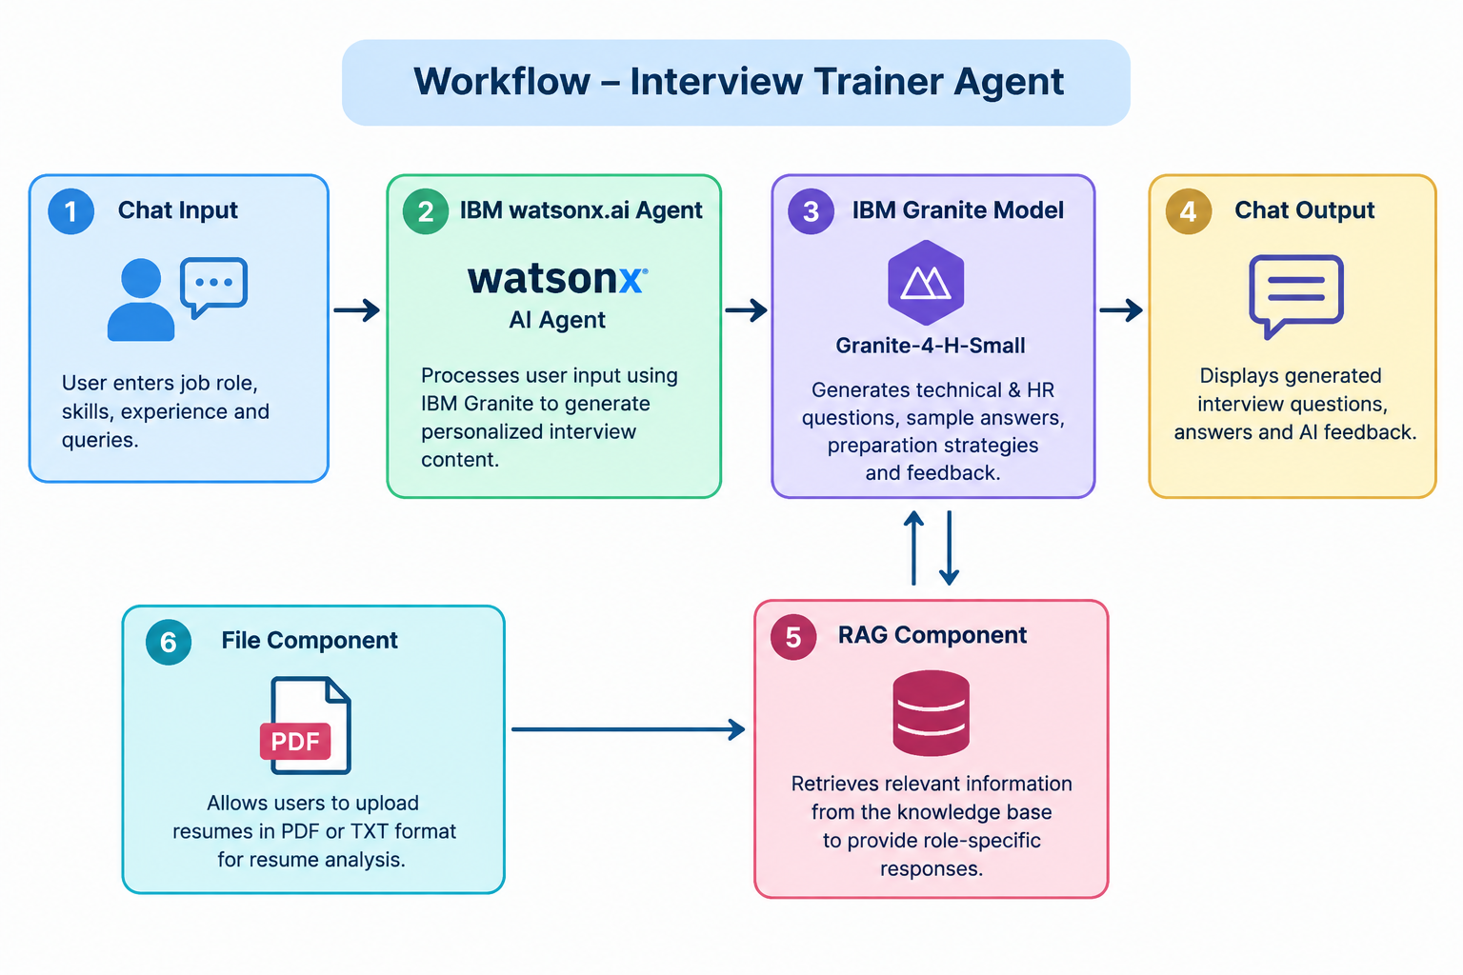
Workflow -

Slide 8
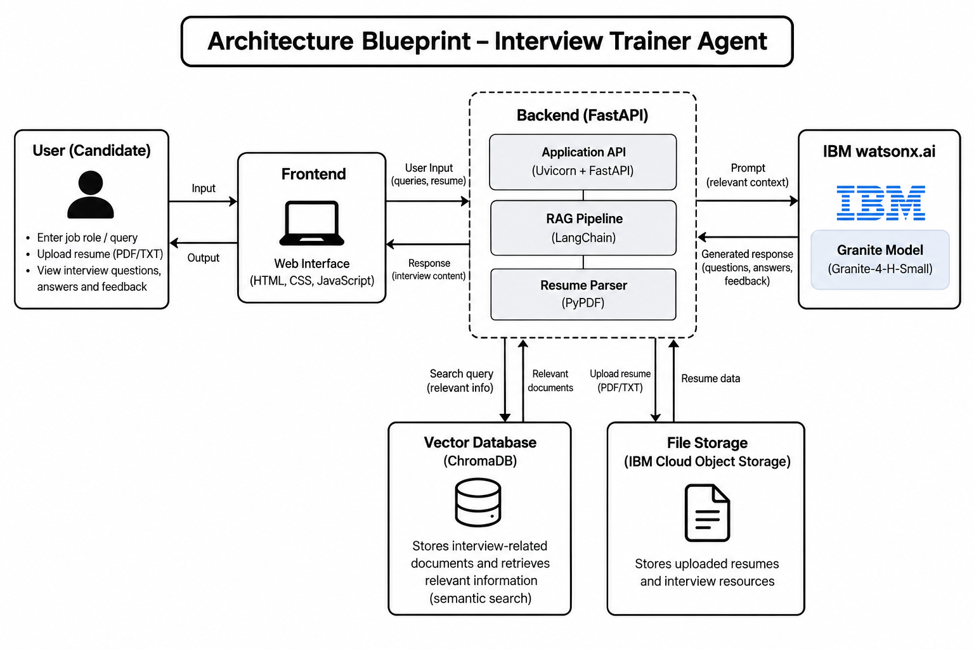
Architecture blueprint

Slide 9
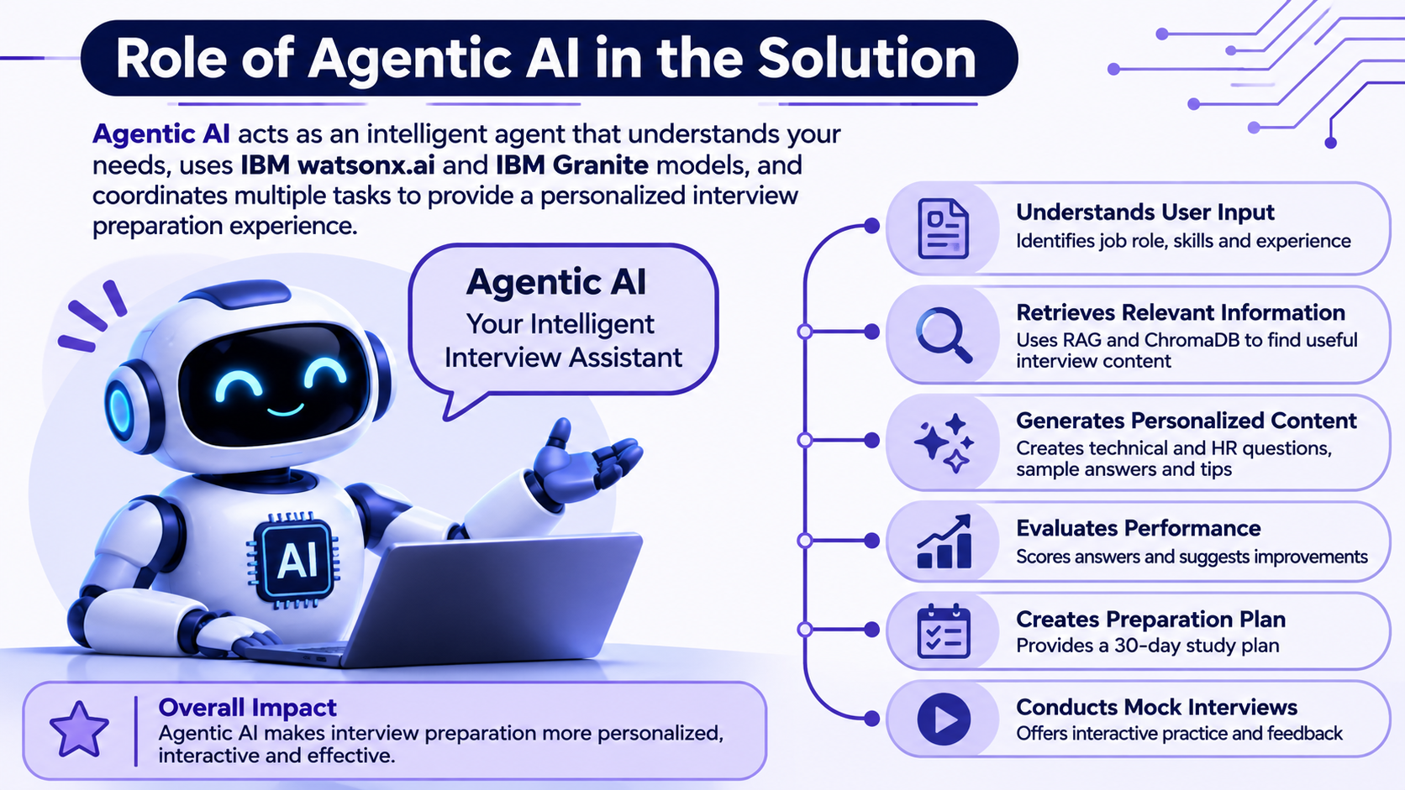
Role of Agentic AI in the solution

Slide 10
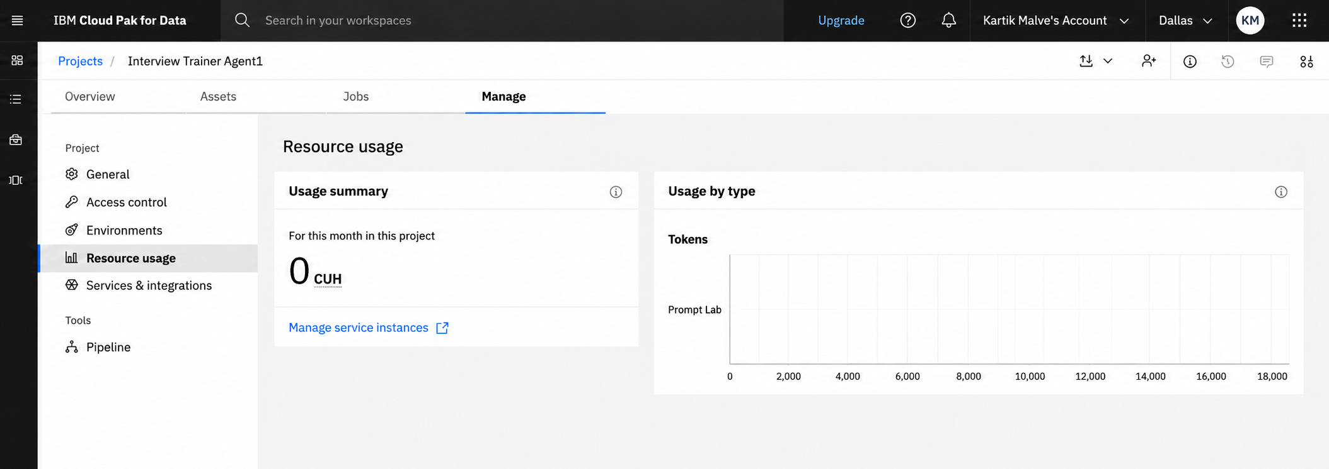
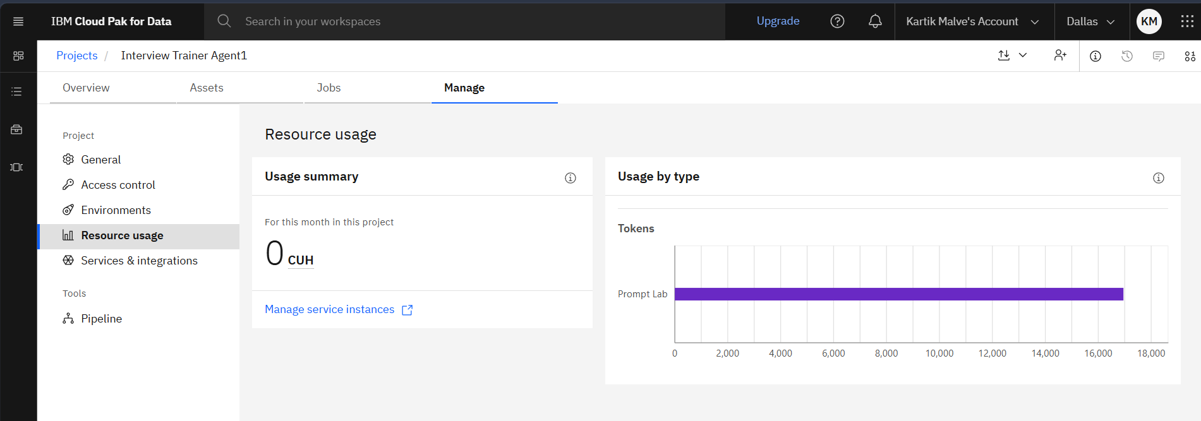
Token Usage
Before Prompt
·
After the Prompt
17000 token are used
·
·

Slide 11
Novelty and Uniqueness
Personalized Interview Preparation: Generates interview questions based on the candidate's resume, skills, experience, and selected job role.
RAG-Based Knowledge Retrieval: Uses Retrieval-Augmented Generation (RAG) with ChromaDB to retrieve relevant interview information and provide role-specific responses.
IBM Granite Integration: Uses IBM Granite through watsonx.ai to generate technical questions, HR questions, sample answers, and preparation guidance.
Automated Answer Evaluation: Evaluates candidate responses, provides scores, identifies knowledge gaps, and suggests improved answers.
Adaptive Mock Interviews: Supports interactive mock interviews and provides feedback based on candidate responses.
Personalized Preparation Strategy: Generates a structured 30-day preparation plan according to the candidate's requirements.
All-in-One Interview Assistant: Combines resume analysis, question generation, answer evaluation, mock interviews, and performance reporting in one application.

Slide 12
Git Hub Link
Github URL
kartikvmalve/IBM-Bob---Interview-Trainer-Agent: Project based on IBM Bob Interview Trainer Agent
·
·

Slide 13
Future Scope
Voice-Based Interviews: Add voice interaction to make mock interviews more realistic.
Video Interview Analysis: Analyze facial expressions, confidence, and communication skills.
Multilingual Support: Support multiple languages for interview preparation.
More Job Roles: Expand the knowledge base to cover more industries and job profiles.
Real-Time Feedback: Provide instant feedback on answers during mock interviews.
Resume Improvement: Suggest changes to improve resumes according to job requirements.
Job Portal Integration: Connect with job portals to provide preparation based on actual job descriptions.
Progress Tracking: Track user performance and show improvement over time
·
·
·

Slide 14
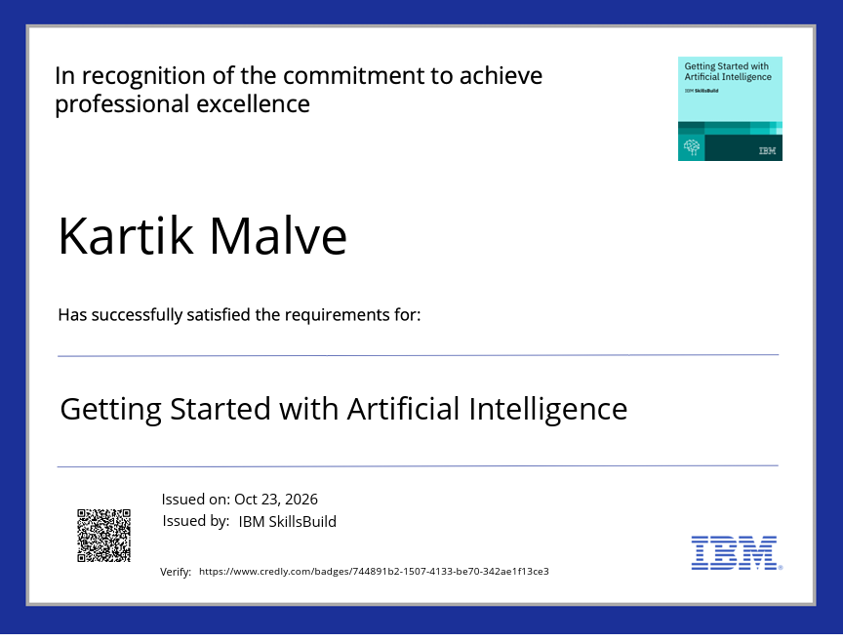
Certificates Earned:
Credly certificate

Slide 15
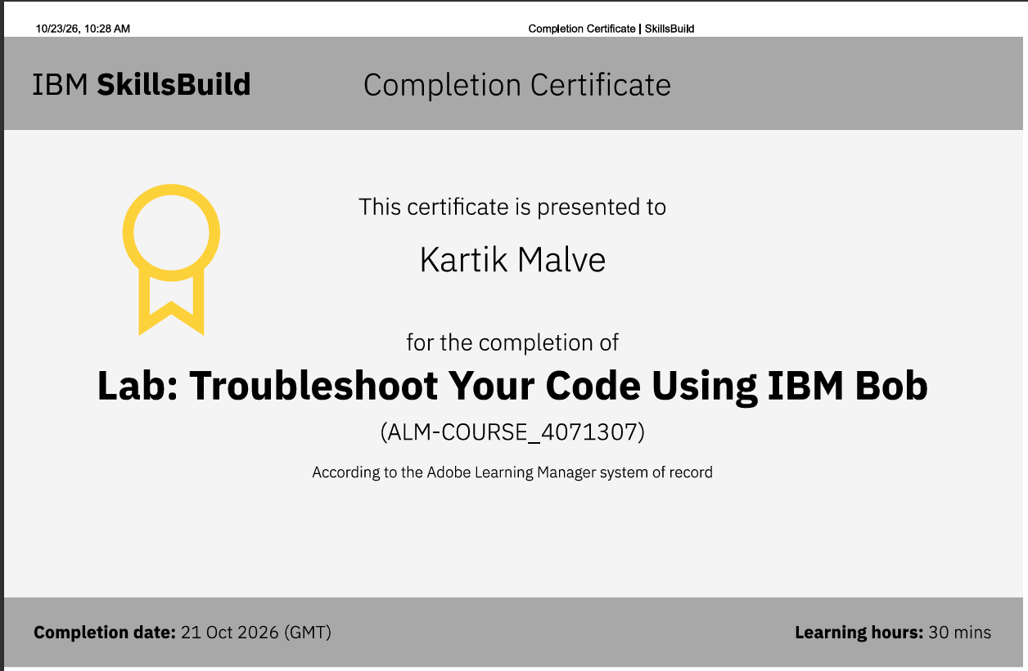
Certificates Earned:​
IBM BOB Certificate

Slide 16


